Slide 1
分布式系统测试
2018年01月

Slide 2
Outline
测试方法
Cloudera
开源工具
TiDB
我们的计划

Slide 3
测试方法
错误注入
Linearizaiblity checking
NP-complete
自动化运行调度
随机的并发访问，什么是“正确”的结果？

Slide 4
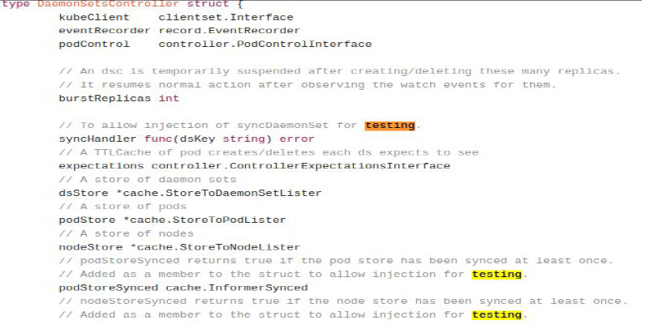
测试方法
错误注入
代码注入
目前对我们不适用

Slide 5
测试方法
错误注入
Hardware
disk error
network card
cpu
clock
Software
file system
network & protocol
...

Slide 6
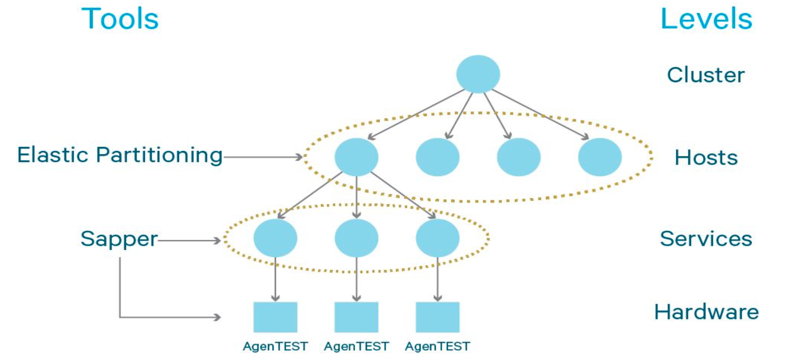
Cloudera
Sapper是服务相关的，比如HDFS上的NameNode，或DataNode

Slide 7
Cloudera
AgentTEST可以模拟的错误注入
Packets reject. Drop all the packets from/to the specified address and port and reply with the tcp-reset or port-unreachable error codes.
Packets drop. Quietly drop all the packets from/to the specified address and port.
Packets loss. Drop a configurable % of packets to the specified address and port.
Packets corrupt. Corrupt a configurable % of packets to the specified address and port.
Packets reorder. Reorder a configurable % of packets to the specified address and port.
Packets duplicate. Duplicate a configurable % of packets to the specified address and port.
Packets delay. Introduce a configurable delay for packets sent to the specified address and port.
Bandwidth limit. Limit the network bandwidth for the specified address and port.
DNSFail. Apply an injection to let the DNS fail.
FLOOD. Starts a DoS attach on the specified port.
BLOCK. Blocks all the packets directed to 10.0.0.0/8 (used internally by EC2).
SIGSTOP. Pause a given process in its current state.
BurnCPU. Run CPU intensive processes, simulating a noisy neighbor or a faulty CPU. It is possible to specify the amount of cores to burn.
BurnIO. Run disk-intensive processes, simulating a noisy neighbor or a faulty disk. It is possible to specify the amount of IOPS to burn and the mount point which is to be affected.
FillDISK. Write a huge file to the specified root device, filling up the root disk. It is possible to specify the percentage of free disk space to consume.
CorruptHDFS. Corrupt one HDFS file using the size and the offset provided in input.
RONLY. Remount as readonly one mounting point of a device.
FIllMEM. Consume memory. It is possible to specify the percentage of free memory to consume.
HANG. Hang a host running a fork bomb.
PANIC. Force a kernel panic.
Suicide. Shut down the machine.
网络
操作系统

Slide 8
开源工具
错误注入
libfiu: 模拟POSIX随机错误
CharybdeFS: 模拟文件系统错误注入
Simulate the following errors:
disk IO error (EIO)
driver out of memory error (ENOMEM)
file already exists (EEXIST)
disk quota exceeded (EDQUOT)
Notes:
fiu-run -x -c “enable_random name=posix/io/*,probability=0.05” bin/mysqld –
basedir=/data/ushastry/server/mysql-5.6.24 –datadir=/data/ushastry/server/mysql-5.6.24⁄76020 –core-file –socket=/tmp/mysql_ushastry.sock –port=15000
CharybdeFS: A new fault-injecting file system for software testing
Simulate the following errors:
disk IO error (EIO)
driver out of memory error (ENOMEM)
file already exists (EEXIST)
disk quota exceeded (EDQUOT)

Slide 9
开源工具
Jepsen: Distributed Systems Safety Analysis
一个control节点，多个被控制节点
control node 会启动很多进程，每一个进程都能使用特定的 client 访问到我们的分布式系统。一个 generator 为每一个进程生成一系列的操作每一个操作都会被记录到 history 里面。
在执行操作的同时，另一个 nemesis 进程会尝试去破坏这个分布式系统，譬如使用 iptable 断开网络连接等，当所有操作执行完毕之后，jepsen 会使用一个 checker 来分析验证系统的行为是否符合预期
Notes:
linearizability checking is NP-complete
Be advised that tests may mess with clocks, add apt repos, run killall -9 on processes, and generally break things, so you shouldn't, you know, point jepsen at your prod machines unless you like to live dangerously, or you wrote the test and know exactly what it's doing.

Slide 10
开源工具
Jepsen
written by clojure
linearizability验证
Knossos- 基于历史
A linearizability checker takes as input a sequential specification and a concurrent history, and it runs a decision procedure to check whether the history is linearizable with respect to the spec.

Slide 11
开源工具 Netflix
Chaos Monkey is a service which identifies groups of systems and randomly terminates one of the systems in a group.
The service operates at a controlled time (does not run on weekends and holidays) and interval (only operates during business hours).
Chaos Monkey
Spinnaker
multi-cloud continuous delivery platform that helps you release software changes with high velocity and confidence.
cluster management and deployment management.

Slide 12
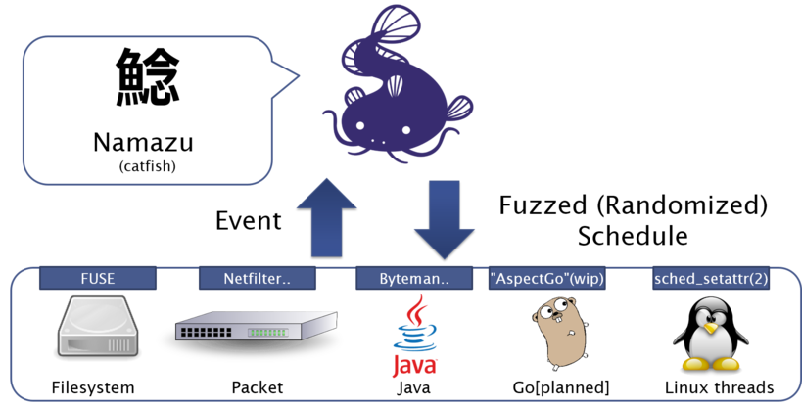
开源工具
Namazu permutes Java function calls, Ethernet packets, Filesystem events, and injected faults in various orders so as to find implementation-level bugs of the distributed system.
Namazu can also control non-determinism of the thread interleaving (by calling sched_setattr(2) with randomized parameters).
Its design does not depend on programming languages and opearting systems.
Namazu

Slide 13
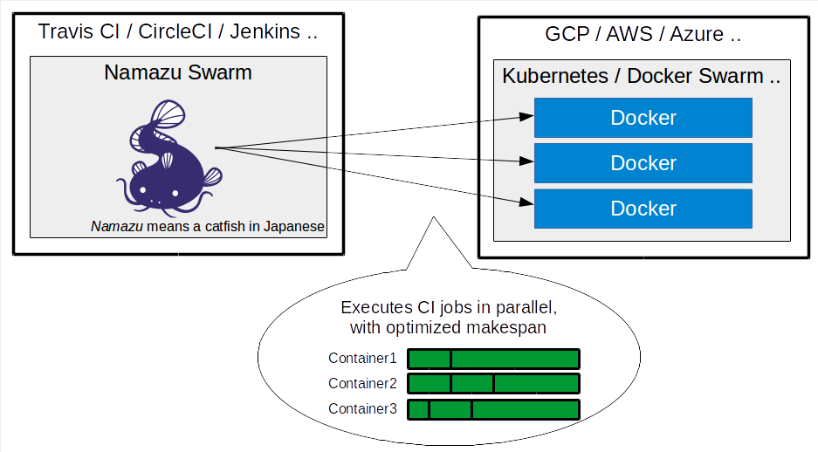
开源工具
Namazu Swarm: CI Job Parallelizer built on Docker and Kubernetes
Namazu
a programmable fuzzy scheduler for testing distributed systems.

Slide 14
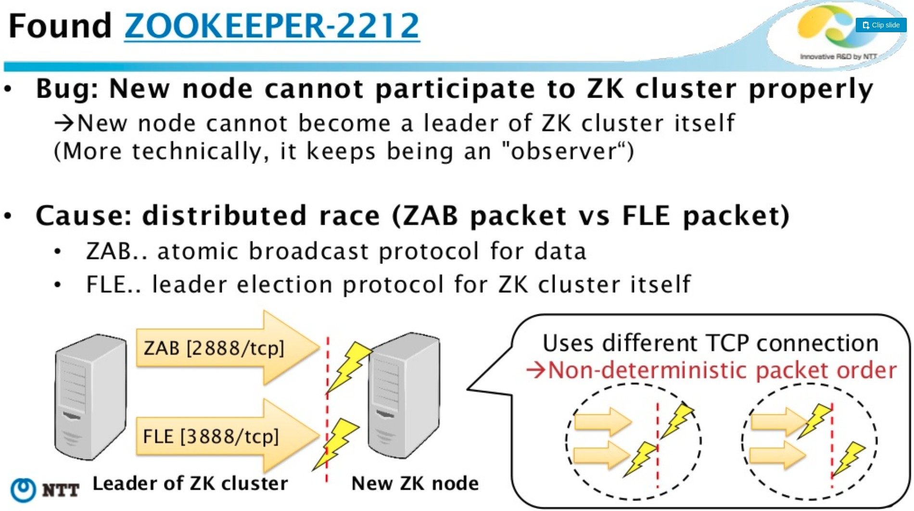
开源工具
Namazu

Slide 15
more tools
etcd local tester
https://github.com/NetSys/demi
类似Namazu, Akka, 测试Spark
american fuzzy lop
Notes:
The etcd local-tester runs a fault injected cluster using local processes. It sets up an etcd cluster with unreliable network bridges on its peer and client interfaces.
The cluster runs with a constant stream of Put requests to simulate client usage. A fault injection script periodically kills cluster members and disrupts bridge connectivity.

Slide 16
TiDB
Jepsen
https://github.com/pingcap/jepsen/tree/master/tidb
The tests run concurrent operations to some shared data from different nodes in a TiDB cluster and checks that the operations preserve the consistency properties defined in each test.
Tests
* bank concurrent transfers between rows of a shared table
* sets concurrent unique appends to a shared table
* register concurrent atomic updates to a shared register
Nemeses
* parts random network partitions
* majority-ring random network partition where each node sees a majority of other nodes
* start-stop-2 db processes on 2 nodes are stopped and restarted with SIGSTOP/SIGCONT
* start-kill-2 db processes on 2 nodes are stopped with SIGKILL and restarted from scratch
Notes:
we only use namazu to simulate file system, and use etcd local tester to simulate network

Slide 17
TiDB
Chaos
https://github.com/siddontang/chaos
written by go,模仿Jepsen
linearizability checker
Porcupine(基于论文Faster linearizability checking via P-compositionality)

Slide 18
TiDB
Namazu
How TiKV use namazu
Use nmz container / non-container mode to disturb cluster.
Run container mode in CI for each commit. (1 hour)
Run non-container mode for a stable version. (1 week+)
Use extreme policy for process inspector
Pick up some processes and execute them with SCHED_RR scheduler. others are executed with SCHED_BATCH scheduler
Use [0, 30s] delay for filesystem inspector

Slide 19
TiDB
How TiKV simulate network transport
Drop/Delay messages randomly
Isolate Node
Partition [1, 2, 3, 4, 5] -> [1, 2, 3] + [4, 5]
Out of order messages
Filter messages
Duplicate and send redundant messages
可能是etcd local tester

Slide 20
我们的计划
2018Q1
chaos能够[在容器上]跑起来(或者Jepsen)，了解注入和验证的实际过程
顺便熟悉go，能够改写测试用例
2018Q2
Namazu 能够在容器上跑起来，并扩充测试条件
比如网络注入
比如文件系统的注入有哪些案例
TBD:形成CI测试机制,自动化测试系统

Slide 21
Thank you!

